Slide 1
Miracle Software Systems Corporate Standards - Title Page
Title: Cricket Player Management Application
Subtitle: Utilizing Linked List, Undo Stack, and Hash Table in Python
Name: GUNREDDY NIKHIL REDDY
DATE: September-13-2024

Slide 2
Project Overview
Technologies & Tools
Data Structures Overview
Core Functionalities
Application Architecture
JSON File Structure
Demonstration of the Application
Challenges and Solutions
What I Learned
Future Improvements

Slide 3
Project Overview
Objective:
Build a console-based cricket player management application using data structures.
Implement core functionalities like Add, View, Edit, Delete, Search, and Undo actions.
Features:
Manage player records using a linked list.
Store and search data using a hash table.
Implement undo functionality with a stack.
Store data in a JSON file for persistence.

Slide 4
Technologies & Tools
Programming Language: Python
Data Storage: JSON
File Handling: Using the os and json modules to read and write player data.
Data Structures:
Linked List for managing player data.
Stack for implementing the Undo feature.
Hash Table for efficient searching.

Slide 5
Data Structures Overview
Linked List:
Used to store cricket player records.
Each node contains player data (ID, Name, Country, Role, Team) and a pointer to the next node.
Hash Table:
Stores players by their ID for fast lookups.
Search by keyword functionality is implemented using this data structure.
Undo Stack:
Tracks the last action (Add, Edit, Delete) performed.
Enables users to undo the last change.

Slide 6
Core Functionalities
Add Player: Adds a new player to the list and saves the data in JSON.
Edit Player: Modifies an existing player’s details.
Delete Player: Removes a player from the linked list and JSON file.
Undo: Reverts the last action, restoring the previous state.
Search: Allows searching for players by name using the hash table

Slide 7
Application Architecture
File Handling:
Data is stored in cricket_players.json for persistence.
Uses os.path.exists() to ensure the file is accessible.
Data Structures Integration:
Linked List: For managing player data in sequential order.
Undo Stack: For tracking actions.
Hash Table: For searching players efficiently.

Slide 8
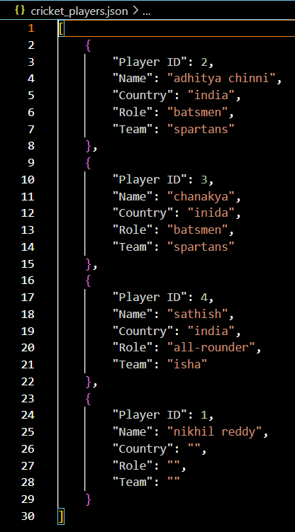
JSON File Structure
Example of the Json output:
Benefits:
Portable and human-readable.
Easily integrates with Python's json module.

Slide 9
Demonstration of the Application
Demo Process:
Adding a Player: Input player details (name, country, role, team).
Editing a Player: Modify existing details.
Undo Action: Demonstrate undo after adding/editing a player.
Searching: Show keyword-based search using the hash table.
Output in JSON: Demonstrate how data is stored and updated in the JSON file.

Slide 10
Challenges and Solutions
Challenge: Handling invalid user inputs and file access permissions.
Solution: Used input validation and proper error handling with os for file paths.
Challenge: Implementing Undo functionality efficiently.
Solution: Used a stack to track actions and revert them.

Slide 11
What I Learned
Data Structure Implementation:
How to build a Linked List, Stack, and Hash Table in Python.
How to apply these structures to a real-world problem.
File Handling:
Reading and writing JSON data.
Using the os module for path and permission handling.
Application Design:
Structuring a Python application with modularity.
Using data persistence to store and retrieve player data.

Slide 12
Future Improvements
Enhanced UI: Add a graphical user interface for better user interaction.
Player Stats: Extend the application to include detailed player statistics.
Database Integration: Move from JSON to an actual database for larger datasets

